Slide 1


Email Writing
The art of writing an official electronic mail
SCHOOL OF PROFESSIONAL ENHANCEMENT

Slide 2
Email writing is correspondence through electronic media.
Easier to use and much productive, emails can also retain a copy of all information exchanged (be careful of what you put in black and white)
6 Simple things to remember:
  “From” address can be ignored as it is usually filled in by default
  Date is displayed in the inbox
  Subject of an email is very important from an operational point of view, even if you are able to send an email without it.
  Checking and rechecking recipient’s addresses and priority among them and maintaining privacy among them are important tasks to be done before mailing.
  Emails are expected to be brief and customized applications may even have a word limit.
  A standard closing, with the sender’s details and designation, is a widely expected condition currently.
SCHOOL OF PROFESSIONAL ENHANCEMENT

Slide 3
Basic email structure
Learn the poem to remember. | Content
Something old. | Recipient’s information
Something new. | Subject
What to do? | Salutation and what you wish to convey him or her.
I love you! | (Signoff / Closing / Ending) with your details
SCHOOL OF PROFESSIONAL ENHANCEMENT

Slide 4
Let’s start the task!
Start with a blank sheet
  Decide upon the fictional details such as your company, designation, your intended recipient’s, etc.
Choose a scenario (assuming you are an employee in a fictional company)
  Informing a superior of delay in submission of a project
  Resignation letter
  Requesting for a transfer / shift change / additional resources
  Complaint / Grievance / Feedback letter
  Ask any queries to the faculty, before you start. Let’s aim to write an email without any editing!
SCHOOL OF PROFESSIONAL ENHANCEMENT

Slide 5

Step 1: A) Decide on a fictional email address and make it professional
Q. Which of the following are acceptable for a professional?
iam_newsrk@email.com
85848582_wtd@email.com
Anil.sharma@email.com
Cutiepie.pinky@email.com
Michael.1988@email.com
Rahulluvs_everyone@email.com
B) Decide on recipient addresses now.
SCHOOL OF PROFESSIONAL ENHANCEMENT

Slide 6
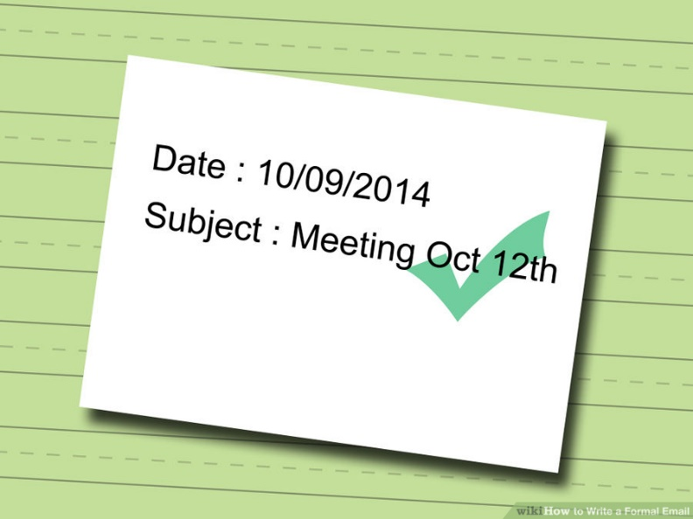
Step 2: Depending on the scenario you have selected, write the subject.
(Subject needs to be brief and concise. Remember to make it a practice.)
SCHOOL OF PROFESSIONAL ENHANCEMENT

Slide 7
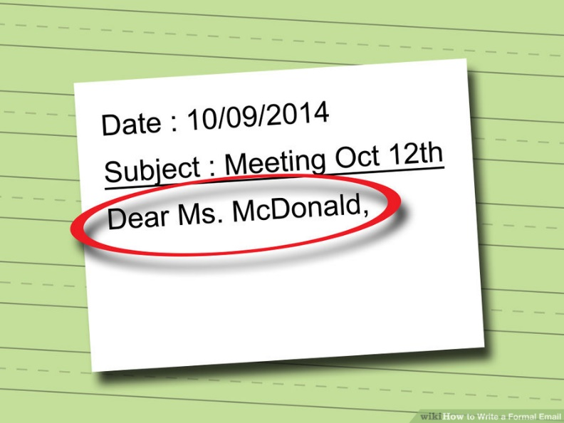
Step 3: Write the relevant salutation and greeting.
(Relationship with the recipient and gender are deciding factors here)
Q. You are working with Accenture, writing to a superior requesting a day off for personal purposes. She is a seasoned employee of the company and very strict. Which of the following can be used for as a salutation for the letter?
Dear Mr. Sharma
Dear Ms. Sharma
Dear Anu
Respected Mam
Mam
Dear Ma’am
SCHOOL OF PROFESSIONAL ENHANCEMENT

Slide 8
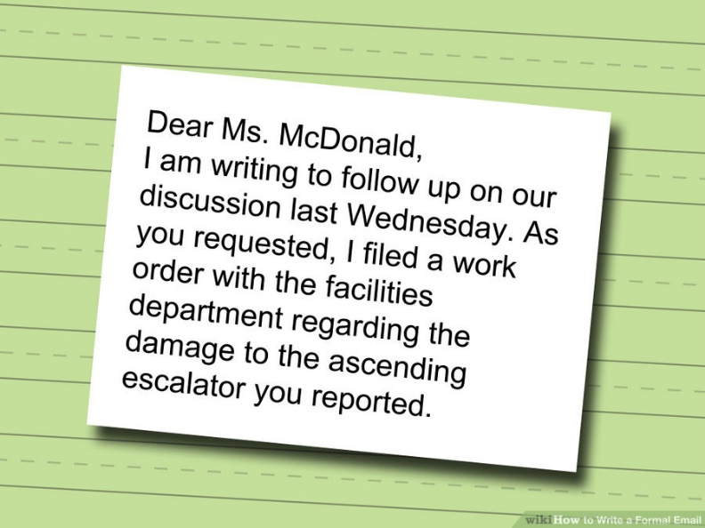
Step 4: Compose the body of the text.
Mentally prepare an organized sequence of statements before you put the pen to the paper and make it as concise as possible.
Use a formal opener like “This is to bring to your notice”, “ This is in reference to” or “This is in regards to …”. Any other opening line can also be used as long as the professionalism is maintained.
Use appropriate niceties such as “ Please” , “I request” and “Kindly”, but don’t overdo it.
Create a one line conclusion or ending, which indirectly points out that the body of the text is brought to a closure. (Don’t start a different topic or go back to arguments again.)
SCHOOL OF PROFESSIONAL ENHANCEMENT

Slide 9
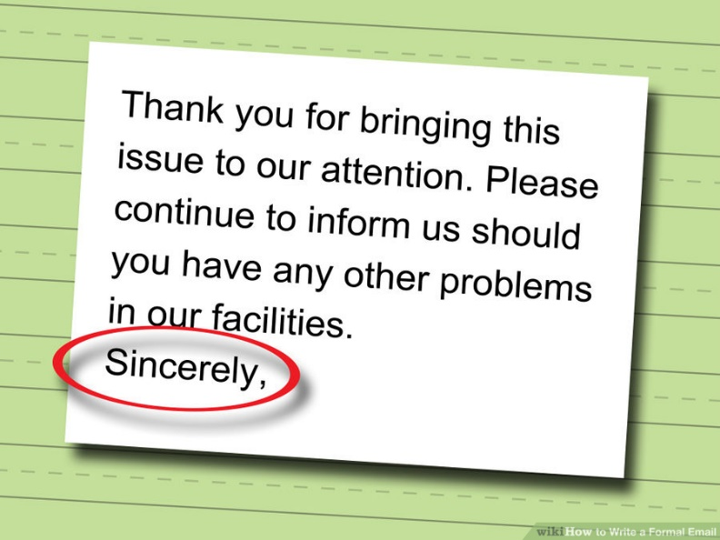
Step 5: Sign off the email
(This part is labelled as signoff, closing, ending, closure in different sources in the Internet)
There are no perfect ways to sign off.
Professionals are advised to keep it neutral using words and phrases such as “Regards”, “Sincerely”, “Warm regards” and “ Best regards”.
Make it look earnest, but not too pathetic and desperate.
Students are encouraged to bring out samples to clarify them with the faculty
Items like Luv, Cya soon, Loads of love are to be avoided.
SCHOOL OF PROFESSIONAL ENHANCEMENT

Slide 10
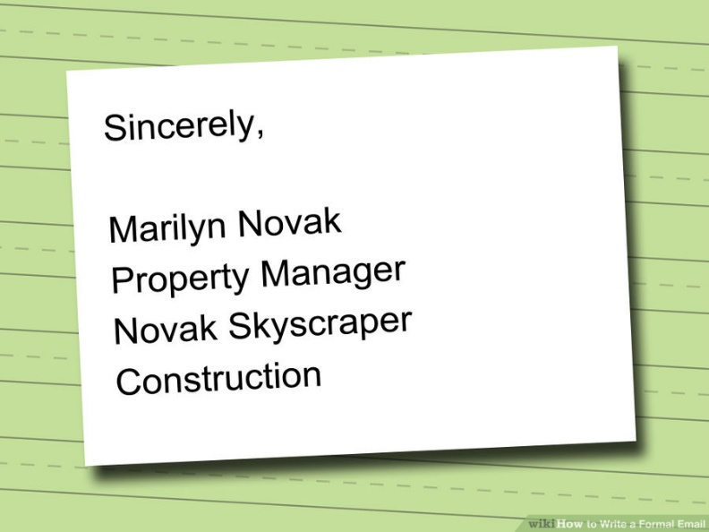
Step 6: Write your details
(Your name as in the company information, designation, department or division, contact(optional))
Short forms of your name are to be avoided if writing a formal mail or to someone for the first time.
Educational qualifications are not mandatory. (Adding Dr. or PhD to a name, if applicable, is expected.)
Designation must be informative and formal, not bragging.
For large organizations or when writing across departments, your division or department details could be very helpful.
Email writing practice is done in paper, but it still is an email, hence DO NOT ADD A SIGNATURE!
SCHOOL OF PROFESSIONAL ENHANCEMENT

Slide 11
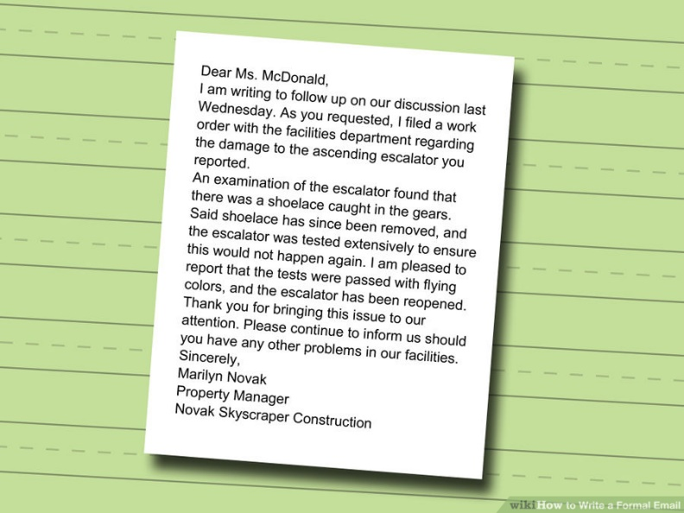
Step 7: View your email
See if it serves the purpose (as per the question, not your opinion).
Check if the parts are filled up and are in correct sequence.
Raise a query to the faculty for filling any loose ends.
SCHOOL OF PROFESSIONAL ENHANCEMENT

Slide 12
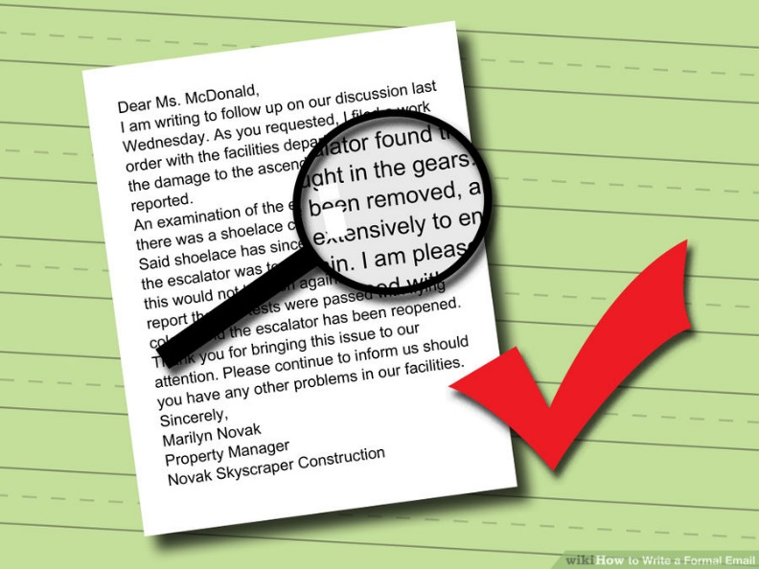
Step 8: PROOF READ
(Most important piece of any document writing exercise, that has become a million dollar industry.)
Check for typographical errors, spelling mistakes, punctuations, confusing pronoun references and possibly misleading statements.
If possible, share it with another person and get it checked, for a neutral viewpoint.
If you have completed all the steps and you have understood the reasons behind them, you are good to go!
Now practice with different scenarios, in a timed condition.
SCHOOL OF PROFESSIONAL ENHANCEMENT

Slide 13
Exercises
TCS New Verbal Elimination Round – Sept 2014
Directions:
1. Use all the phrases given in the question.
2. Minimum words should be 50 otherwise your email cannot be validated.
3. Addressing and signing should be done as in the question given.
4. Common grammatical rules, punctuation should be according to standard English.
5. You can use your own phrases along with the phrases given.
DO NOT ASSUME ANYTHING, CLARIFY BEFORE YOU START!
SCHOOL OF PROFESSIONAL ENHANCEMENT

Slide 14
Choose any 1 and complete it in 20mins.
Q1. Using the following phrases, write an email with minimum of 70 words to the customer Mr. Gill Roy explaining delay to the project.
Payment processing system – Schedule – 10th May (Friday) – Unexpected power outage – 3 days – Overall delay – 7 days – includes recovery of lost work – will not recur
Q2. You are a part of corporate communication team in your company. The working time period is revised as 8:30 am to 5:00 pm. Using the following phrases, write an email with a minimum of 70 words and a maximum of 100 words to the employees in your company informing the same.
by 30 minutes to avoid traffic - effect from next week - lunch duration-revised working time - reduced by 10 minutes-free breakfast-office will start earlier-till the end of rainy season-will be in effect
Q3. As your company is doing good business and expanding, your company is relocating it's office to a new address. Using the following phrases, write an email with a minimum of 70 words and a maximum of 100 words to your customer informing the change in address.
near outer ring road-shifting to-bigger office space-November 10-change in telephone number-new address is provided below-fourth floor-Cesina Business Park
Q4. You are the project leader for a team of 20 members. As the team members are not submitting the weekly time sheets regularly, you need to email them stressing the need to submit without fail. Using the following phrases, write an email with a minimum of 70 words and a maximum of 100 words to your team members informing the same.
can be accessed online-lead to loss of pay-every week-do not default-used to bill client-actual working hours-by friday-failure to adhere-time sheet filling application
SCHOOL OF PROFESSIONAL ENHANCEMENT

Slide 15
DISCUSSION AND REVIEW
SCHOOL OF PROFESSIONAL ENHANCEMENT

Slide 16
Choose any 1 from the following and complete it in 15mins.
Q1. As a member of your residential society, write an email to inspector of local Police station, Mr. Sharma, informing him about miscreants who ride their bikes rashly every evening outside your society. Sign the email as William.
residential area - ride - rashly - children - play - elderly - walk - grocery shop - across the road - dangerous - accidents - nuisance - action - immediately
Q2. As a recent buyer of their car, write an email to the Manager of Smart Automotive company, Mr. Ahmed, regarding the poor quality of service facility available in the city. Sign the email as Chopra.
very few - service centers - complaints - pending problems - maintenance - cost - time - delivery - increase - customer satisfaction
Q3. As a former student, write an email to your professor, Mr. Matt, thanking her for teaching and guidance that contributed to your overall development. Sign the email as Peter.
Successful - Placed - grateful - help - advice - grooming - values - shaping my future - sincere – professional
Q4. As an intern at ABC consulting pvt. ltd, write an email to your internship Project Manager, Mr. Ramesh, informing about the progress that you are making and some difficulties that your are encountering. Sign the email as Ben.
Thank - challenging - progress - tight schedule - support - report - analytics - guidance - access - doubt - requirements - design
SCHOOL OF PROFESSIONAL ENHANCEMENT

Slide 17
DISCUSSION AND REVIEW

Slide 18
In the next exercise, you will choose any 1 from the given questions and complete it in 10mins.
Go through your previous mistakes and clarify wherever necessary.
Post completion of the exercise, emails with major editing and omission of phrases will be not be considered as proper submissions.
Time limit is to be strictly followed.
TCS email writing question – Sept 2015
Directions:
1. Use all the phrases given
2. Minimum words should be 50 otherwise your email cannot be validated
3. Addressing and signing should be done as in the question given.
4. Common grammatical rules, punctuation should be according to standard English.
5. you can use your own phrases along with the phrases given.
SCHOOL OF PROFESSIONAL ENHANCEMENT

Slide 19
Choose any 1 from the following and complete it in 10mins.
Q1. As a resident, write an email to the Municipal commissioner of your city, Mr. Ashok, reporting nuisance of a building under construction beside your place. Sign the email as Kumar.
building - construction - long time - three years - water usage - mosquitoes - unhygienic - construction workers - bad behavior - attention -request - action – immediately
Q2. As a student representative of your department, write an email to your batch mates, suggesting a party for Head of Department Prof. Sunil who is retiring next month. Sign the email as Sam.
inform - retire - plan - surprise - party - host - family - exceptional teacher - guide - mentor - groom - students - helpful - together – memorable
Q3. As a student representative of your college, write an email to the Principal of Professional Engineering College, Prof. Deb Chatterjee, inviting his institute to participate in the Technical symposium being organized in your college. Sign the email as Sam.
Invite - technical Symposium - previous - success - expecting - huge participation - latest technology - stalls - demos - interaction - topics - complete - exchange ideas - exciting prizes
Q4. As a supplier, write an email to the manager of M/S Big wheel Manufacturing Company, Mr. Chopra, intimating of their payment that is due for the products delivered to them three months ago. Sign the email as Ramesh
On time - delivery of goods - three months - credit period - overdue - payment - of the earliest - longstanding - relationship
SCHOOL OF PROFESSIONAL ENHANCEMENT

Slide 20
DISCUSSION AND REVIEW
Students must practice to write the average email in 10mins and another 5mins for proofreading, which also checking includes appropriate sender and receiver information.
The End
SCHOOL OF PROFESSIONAL ENHANCEMENT

